Slide 1
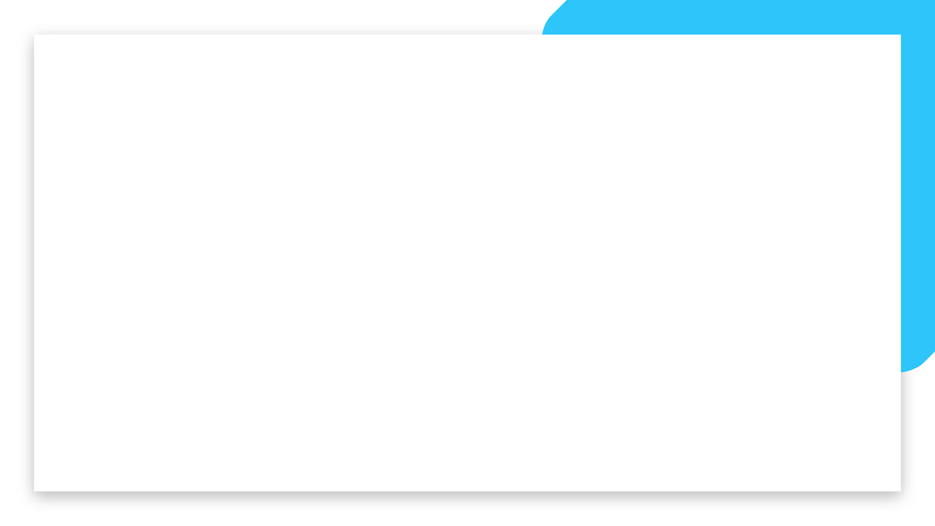


Data Analytics
Part-Time Bootcamp
Day 16

Slide 2
Do you believe in
free will or destiny?

Slide 3

What is the internet?

Slide 4
Basically a bunch of computers connected by optical fibres & electromagnetic waves.

Slide 5
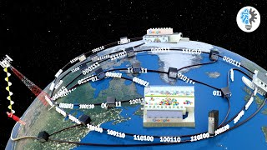
How does it work?

Slide 6
How does it work?
How do we find websites?
How do we browse websites?
What are websites made of?

Slide 7
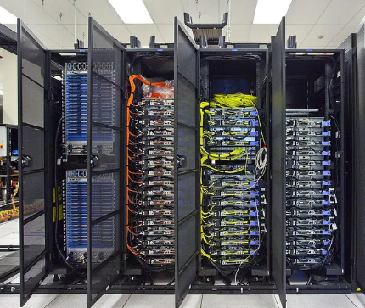
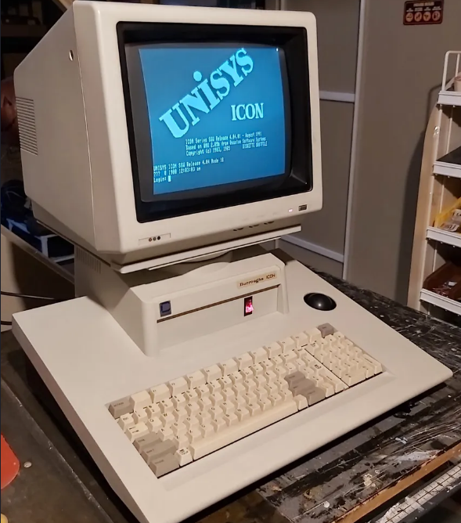
How do we find websites?
How can I get to google.com?
A server is just a computer that serves other computers or devices. Your computer can be a server too but not for many other devices.
I’m not sure…
Let me ask the Root DNS!
Your computer
or laptop
ISP server
A cuter remake of the chart on this website: https://www.mygreatname.com/how-dns-works/e-04-how-dns-works.htm

Slide 8
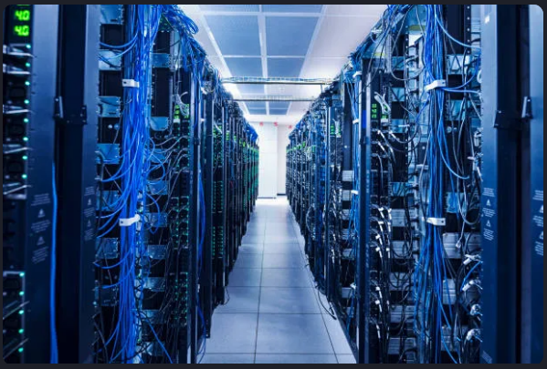
How do we find websites?
Where is google.com?
Oh, The google.com DNS server has it.
ISP server
DNS Root Server
A cuter remake of the chart on this website: https://www.mygreatname.com/how-dns-works/e-04-how-dns-works.htm

Slide 9
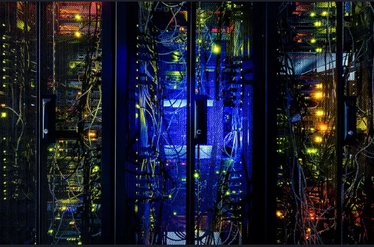
How do we find websites?
Google.com DNS server, where is google.com?
8.8.8.8 and 8.8.4.4.
Thanks!
Whatever.
ISP server
Google.com DNS Server
A cuter remake of the chart on this website: https://www.mygreatname.com/how-dns-works/e-04-how-dns-works.htm

Slide 10
How do we find websites?
Check this out: 8.8.8.8!
Woah! I can search for more stuff?
Umm. Yeah.
Your computer
or laptop
ISP server
A cuter remake of the chart on this website: https://www.mygreatname.com/how-dns-works/e-04-how-dns-works.htm

Slide 11

How do we browse websites?

Slide 12
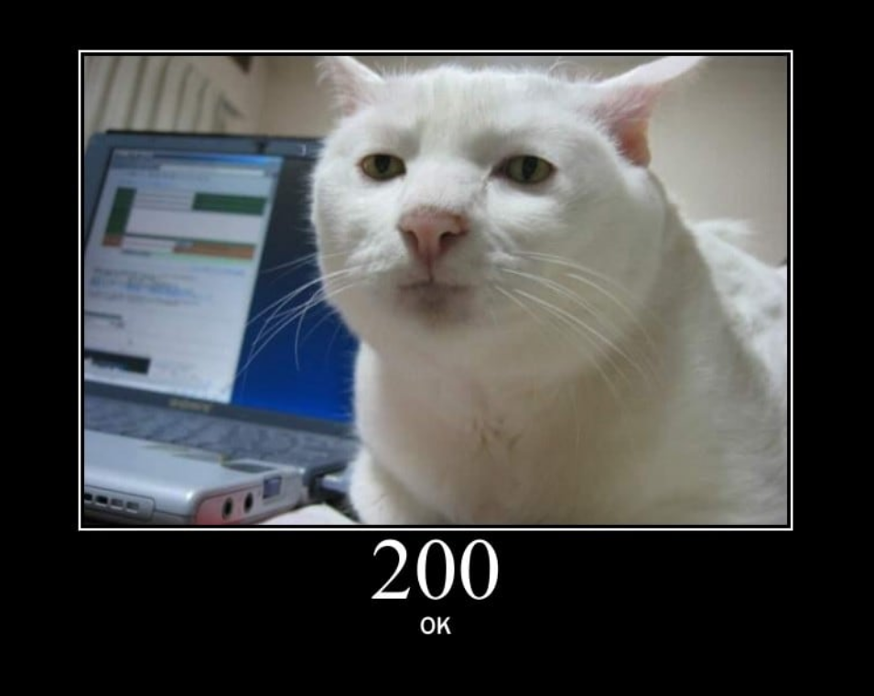
The status cats
Source: https://http.cat/200

Slide 13
What are websites made of?
Developer tools time!
Notes:
Split screen

Slide 14
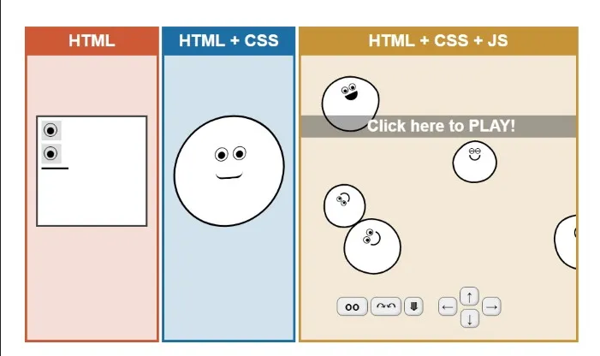
What are websites made of?
Source: https://html-css-js.com/

Slide 15
What are websites made of?
Source: https://html-css-js.com/

Slide 16
How does HTML work?
Source: https://html-css-js.com/

Slide 17
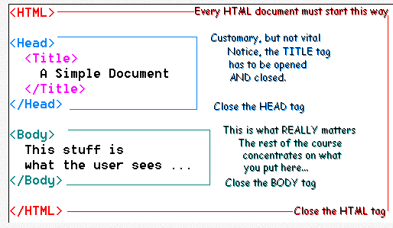
How does HTML work?
Source: https://www.pslc.ws/macrog/quiknote/html/structure/structure.htm

Slide 18
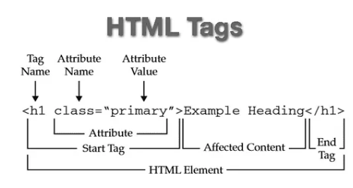
How does HTML work?
Source: https://tutorial.techaltum.com/htmlTags.html

Slide 19
How does HTML work?
Source: https://tutorial.techaltum.com/htmlTags.html

Slide 20
How do we get stuff from the internet?
Notebook time!

